Slide 1
Academic Parent Teacher Team APTT January 2020
Mrs. Archer’s
1st grade

Slide 2
School Of Choice
JMC STEM Charter is proud of be a School of Choice!
Our staff and students put together a video in celebration of National School of Choice Week☺
https://youtu.be/vK-_quIDYMc

Slide 3
Table Talks
Please share with your table group why JMC STEM Charter is your School of Choice. ☺

Slide 4
Agenda What we will cover tonight…
Math Brain Work & Table Talks
Dibels Assessment Data for Jan. 2020 in math & reading
Home Support Resources in math & reading
Math Focus - model math activities
SMART Goals
Info to Know
School Survey
Thank you for coming!

Slide 5
Dibels Math Dynamic Indicators of Basic Early Literacy Skills
Math
Computerized assessment with multiple choice questions
based on 1st grade common core standards
Mid Year Goal = 25
refer to blue sheet to see child’s data
Met Goal – 75%
Approaching Goal – 25%

Slide 6
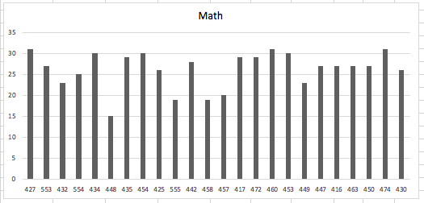
Dibels Math Class Data

Slide 7
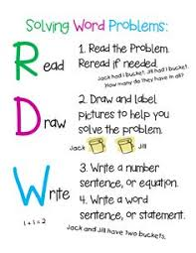
Math Support at Home
RDW Strategies (Read, Draw, Write)
-understand & solve word problems
Flip & Write – practice math facts and build fluency using playing cards
Make a Ten Practice – board game using playing cards to build fluency
Math Facts Flashcards – different levels to meet student needs (count all,
count on, known fact)
Zearn – online math program that supports Engage New York math curriculum
https://www.zearn.org/ (must sign in through Clever tab at bottom of login page)
Greatminds.org – online website for parents that provides additional lesson & homework support
https://greatminds.org/math/parents

Slide 8
Dibels Reading Dynamic Indicators of Basic Early Literacy Skills
Reading
Oral Reading Fluency – Words Correct
This assessment measures the ability to read
accurately and automatically
Mid Year Goal = 19
refer to yellow sheet to see child’s data
Met Goal – 95%
Approaching Goal – 5%

Slide 9
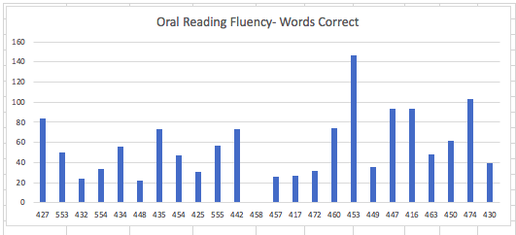
Oral Reading Fluency –Words Correct Class Data

Slide 10
Reading Support at Home
Practice high-frequency words daily (sight, spelling)
Read 20-30 minutes every night
Check that homework is completed
Raz-Kids online reading practice
https://www.raz-kids.com/
Click “Kids Login”
Teacher ID: darcher0 (the “0” is a zero)
Connect Ed – access to Wonders reading program
https://connected.mcgraw-hill.com/connected/
login.do

Slide 11
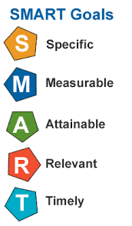
SMART Goals
SMART Goals are defined as:
Specific:
well defined
Clear to anyone that has a basic knowledge of the student
Measureable:
Know if the goal is attainable and how far completion is
Find out when you have achieved your goal
Attainable:
Able to achieve
Relevant:
closely connected and appropriate to content
Time-Bound:
Enough time to achieve goal, but not too much time

Slide 12
Info to Know
1st Grade Report Card
Markings of progress for 1st semester
Pick up at end of meeting
Please contact me with any questions
Field Trip to iFLY in Roseville, CA.
Culminating event of our PBL unit on Flight
Projected Date: Friday, April 3rd
Student donation of $25 – will be sent in Friday Folder
Permission slips & additional info will be sent home mid
February

Slide 13
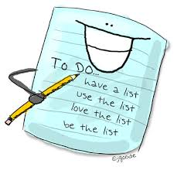
Before you leave…
Please take the following survey before you leave
https://forms.gle/BN8DJcN4oi4ZhQwi8
Pick up child’s Report Card when completed
Thank you for attending tonight’s meeting and your continued support of your child’s education!
☺

