Slide 1
APTT Academic Parent Teacher Team
Mrs. Archer’s 1st Grade 2019-2020
John McCandless Stem Charter School

Slide 2
Agenda
Kahoot Quiz
Welcome & Intro
Procedures Reminders
Homework & Behavior Review
First Grade at a Glance
PBL
APTT
Reading Strategies
Assessment Data & Goal Setting
Contact Info

Slide 3
Kahoot Quiz
Let’s see what you know about Mrs. Archer!
https://kahoot.it/

Slide 4
Introduction
Welcome 1st Grade Families!
A little more info about me…
22nd year of teaching/past 12 under LUSD/founding staff member of JMC
Attended Lincoln schools – graduate of Lincoln High and CSU Stanislaus
Received M ed. in Education Leadership & School Development/Admin Services Credential through Teachers College of San Joaquin in 2012
Excited to be teaching at JM STEM Charter School, which will focus on 21st Century Learning with a STEM emphasis! Equally excited to be at our Riverbrook Campus (formerly Merryhill School) where I began my teaching career over 20 years ago…in the same classroom too!!!
Committed to working together with students and families to ensure students’ success in 1st grade

Slide 5
Procedures
A few reminders…
Breakfast is served from 7:30-7:50 in the Multi-Use Room. Students arriving to school before 7:45 need to report to the MUR and wait to be dismissed to the blacktop area.
Students are not to play before school begins. They may line up and talk calmly in our classroom spot before the bell rings.
Homework Packets go home on Monday and are due back on Friday. Return black Homework Binders daily with Behavior Calendars signed.
OWL Folders go home on Friday. Please empty contents and return on Monday.

Slide 6
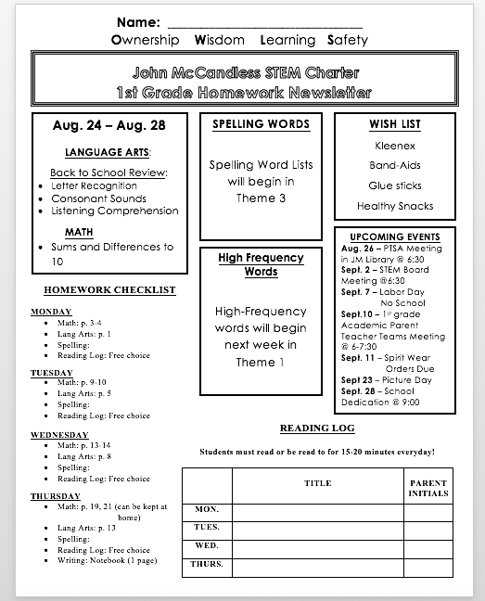
Homework
Homework is a review of 1st grade skills and content being covered in class
Weekly packet sent home on Monday and returned on Friday
Homework consists of three components:
1) Packet:
*Daily pages consisting of math & language arts
2) Reading Log:
*Students should be reading/being read to 15-20 minutes daily
*Log to be filled in and initialed by a grown-up Mon-Thurs
3) Writing:
*Additional page in HW packet (monthly)/Optional home practice
*Writing ideas list in Homework Binder

Slide 7
Behavior Plan
School & Classroom Expectations:
PBIS (Positive Behavior Intervention & Support) behavioral system school wide.
The four main rules that our classroom will focus on are: 1) Be Safe, 2) Be Responsible, 3) Be Respectful and 4) Be a Learner
In being able to connect PBIS into our school environment, we will tie it to our owl mascot and use the O.W.L.S. acronym to encourage positive behavior choices academically and socially.
The letters in OWLS and the expectations each one stands for are:
“O” = Ownership...take care of our school
“W” = Wisdom...make wise decisions
“L” = Learning...ensure all can learn
“S” = Safety...keep everyone safe
For more detailed information on the PBIS behavior system, please check the Parent Handbook.

Slide 8
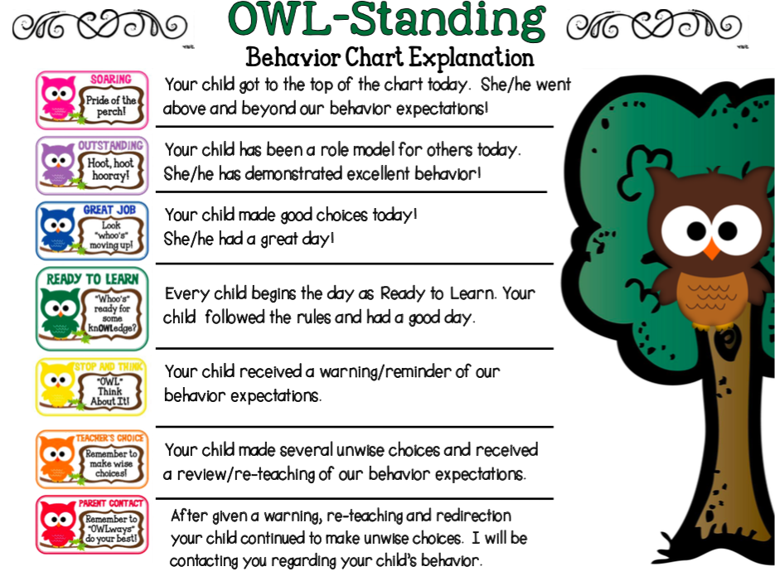
Behavior Plan (con’t)
Individual: clip chart system in which colors reflect student behavior.
Pink = Soaring
Purple = Outstanding
Blue = Great Job
Green = Ready to Learn (all students start here)
Yellow = warning/reminder
Orange = time out and/or loss of recess, and
Red = loss of recess/referral to office/parent contact.
If asked to clip down, students will always have the opportunity to clip back up. If needed, a “Calming Corner” will be set up in our classroom for students to go to and reflect on their behavior choices.
Students who earn green or higher on the chart will also receive a ticket(s) at the end of the day. The tickets can then be used for our Friday Prize Drawers!
Students who move to the top of the chart will also choose a coupon that can be redeemed for fun activities in class!
A parent or guardian will need to initial the box on the Behavior Calendar DAILY and binders will be checked on a regular basis!

Slide 9
First Grade at a Glance
ELA:
McGraw-Hill Wonders reading & spelling
CORE & MH high-frequency words
Writing (Wonders, friendly letter, narrative, informative, opinion)
MATH:
Eureka Math: Engage New York
SCIENCE & SOCIAL STUDIES:
Project Based Learning (PBL)

Slide 10
Project Based Learning (PBL)
What is Project Based Learning?
Project Based Learning is a teaching method in which students gain knowledge and skills by working for an extended period of time to investigate and respond to an engaging and complex question, problem, or challenge.
Upcoming Projects:
Animals
Light & Sound
Plants
Flight

Slide 11
APTT
Academic Parent Teacher Teams (APTT):
APTT has two main components:
1.) Classroom Team Meetings
"classroom team" consists of the classroom teacher and all the parents/families
in the class
teacher reviews and explains class-level academic data
teacher provides parents with individual data about their own child's performance and helping parents set 60-day SMART (Specific, Measurable, Actionable, Realistic, and Time-Bound) academic goals for their children.
2.) Teacher Coaching
Teacher models and provides materials for activities that parents can do with their children at home, giving parents time to practice these activities with each other in a small group setting
parents can share tips among themselves.

Slide 12
Reading Strategies
High-Frequency Words
*Read, spell, read/write
*Interactive Word Wall
*Parent Guide to Sight Words
Phonemic Awareness Drills
Student Success Activity Packets
*Phonemic Awareness
*Phonics
*Fluency
*Comprehension

Slide 13
Reading Assessment
Dibels Reading
Nonsense Word Fluency (NWF)
Two Parts: CLS (Correct Letter Sounds)
WRC (Words Read Correctly)
The DIBELS Nonsense Word Fluency (NWF) measure is a standardized, individually administered test of the alphabetic principle including letter-sound correspondence in which letters represent their most common sounds and of the ability to blend letters into words in which letters represent their most common sounds.
Assessment Benchmarks:
CLS: September – 25 January – 54
WRC: September – 2 January - 10

Slide 14
NWF Whole Class Data

Slide 15
Writing Assessments
Writing Types & Purposes
Narrative:
Write narratives in which students recount two or more appropriately sequenced events, include some details regarding what happened, use temporal words to signal event order, and provide some sense of closure
Informative:
Write informative/explanatory texts in which students name a topic, supply some facts about the topic, and provide some sense of closure
Opinion:
Write opinion pieces in which students introduce the topic or name the book they are writing about, state an opinion, supply a reason for the opinion, and provide some sense of closure

Slide 16
Writing Expectations
By the end of first grade in writing, students will…
stay on topic
use capital letters correctly
use punctuation correctly
spell high-frequency words correctly
use appropropriate spacing between words
start sentences with capital letters
include a strong beginning, middle, and conclusion

Slide 17
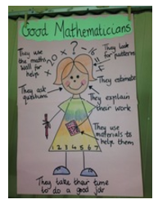
Math Assessment
Dibels Math
Students are assessed on Common Core math standards for first grade
Operations & Algebraic Thinking
Number & Operations in Base Ten
Measurement & Data
Geometry
Assessment Benchmarks:
September – 19 May - 28

Slide 18
Math Whole Class Data

Slide 19
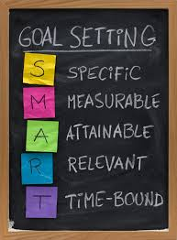
Goal Setting
SMART Goals are defined as:
Specific:
well defined
Clear to anyone that has a basic knowledge of the student
Measureable:
Know if the goal is attainable and how far completion is
Find out when you have achieved your goal
Attainable:
Able to achieve
Relevant:
closely connected and appropriate to content
Time-Bound:
Enough time to achieve goal, but not too much time

Slide 20
SMART Goal Example
Strategies:
1. High-Frequency word flashcards
2. Interactive HF word wall
To help my child reach his/her goal, I will practice the HF word flashcards with him/her using the read, spell, read and read, spell, write strategy.
I will create a HF Word Wall at home that he/she can access.
I will check that my child is using the correct spellings of HF words in writing.
HF Word Flashcards link: https://drive.google.com/drive/folders/1TSocwPdcqTS2jq-IOmFApRTL510C6s6Z?usp=sharing

Slide 21
Contact Info
Communication is vital to ensure student achievement! Please feel free to contact me regarding comments, questions, concerns, and/or suggestions…
Email: darcher@lusd.net
Phone: 888-0160 leave a message and I will return your call
For specific questions regarding your child, please contact me and/or schedule another time to meet
Stay Connected! Class Website: archer1stgrade.weebly.com
School Website: lincolnstemcharter.com
Home & School Messaging: https://www.classdojo.com/
Thank you for your support in helping your child be successful in school…together we will have a fabulous year in 1st grade!
☺

